Slide 1

HMS520-Fall23_Final
Serwah Danquah

Slide 2
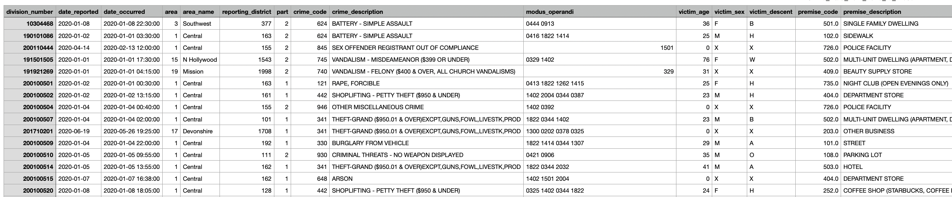
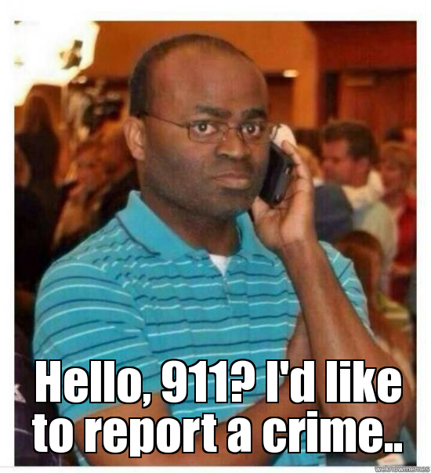
Introduction
https://www.kaggle.com/datasets/asaniczka/crimes-in-los-angeles-2020-2023
Notes:
.

Slide 3
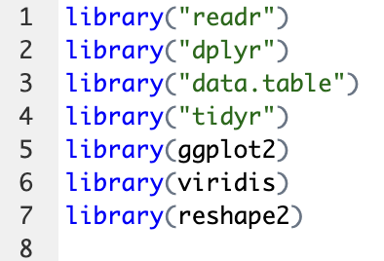
Libraries

Slide 4
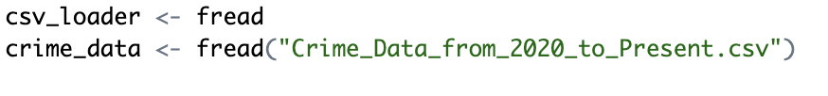
Loading Data

Slide 5
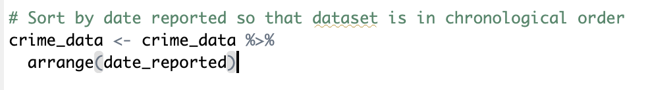
Data Cleaning

Slide 6
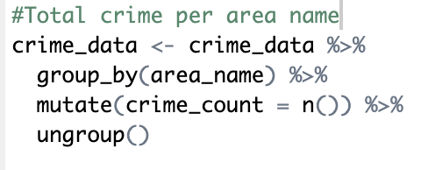
Crime Reported by Area

Slide 7
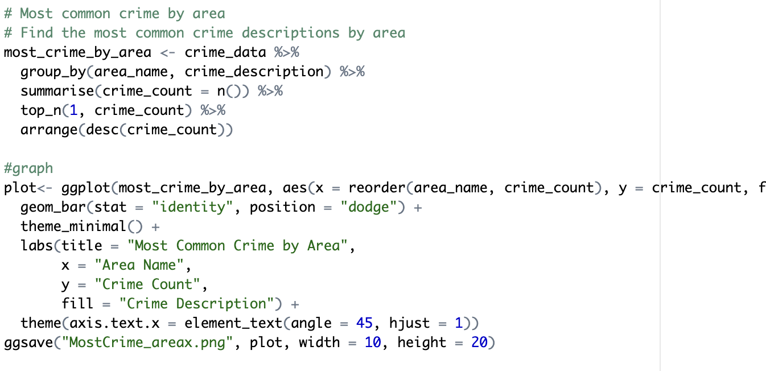
Most Common Crime Reported By Area

Slide 8
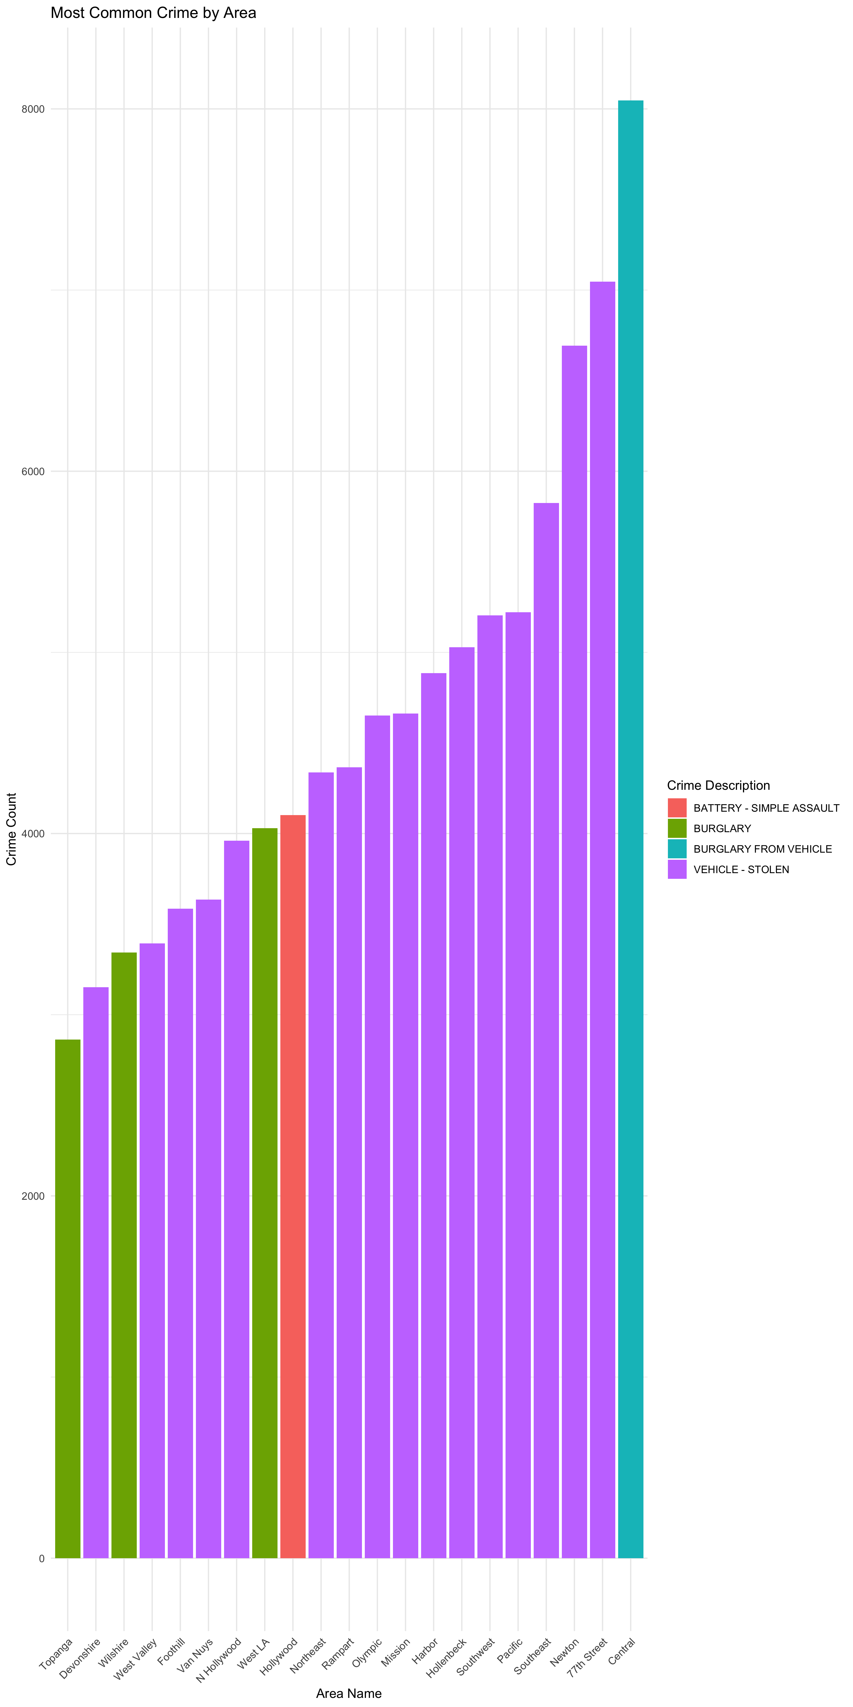
Most Common Crime Reported By Area

Slide 9
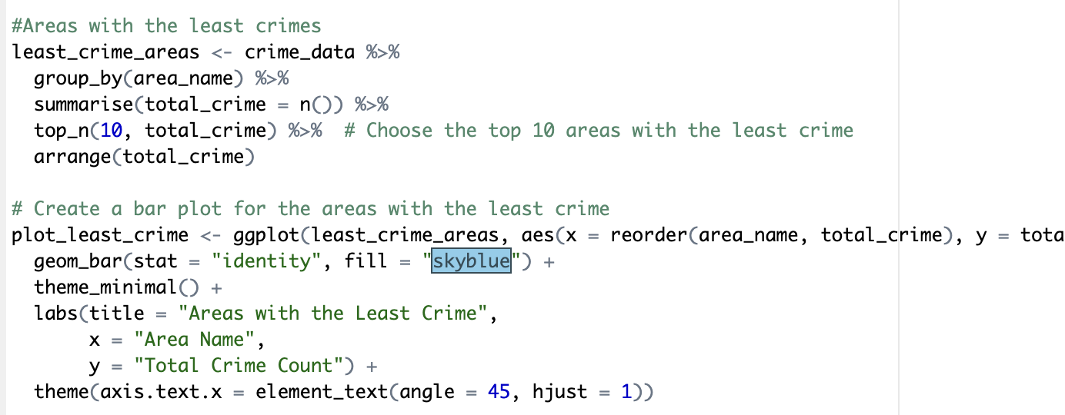
Areas with Least Crimes Reported

Slide 10
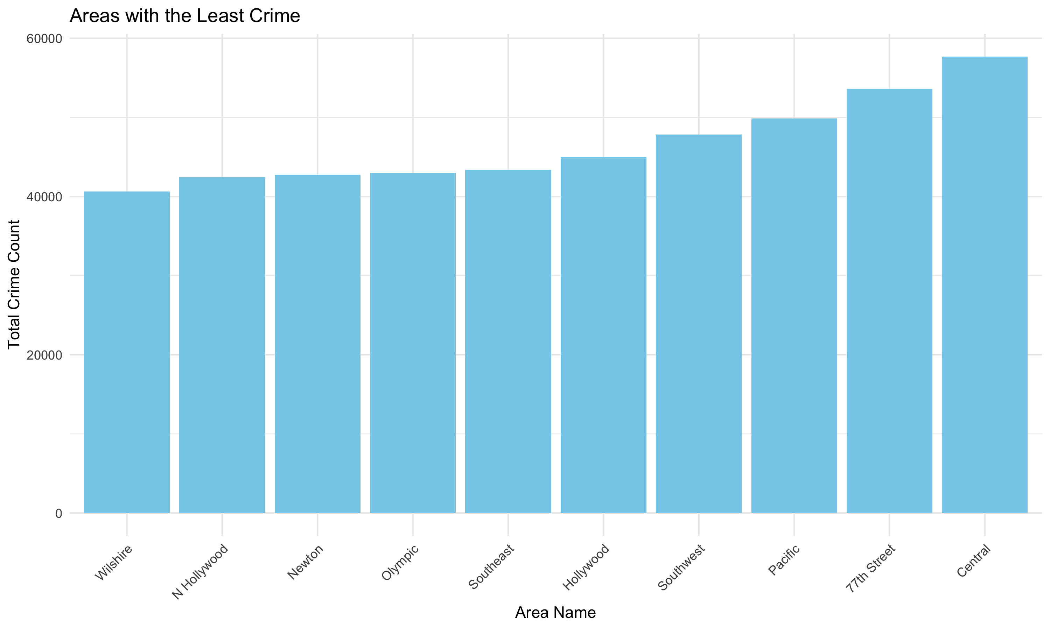
Areas with Least Crimes Reported

Slide 11
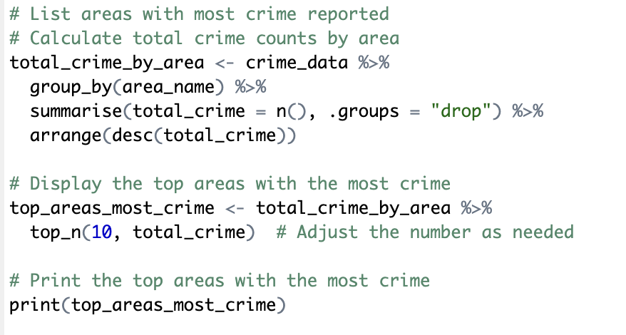
Areas with Most Crime Reported

Slide 12
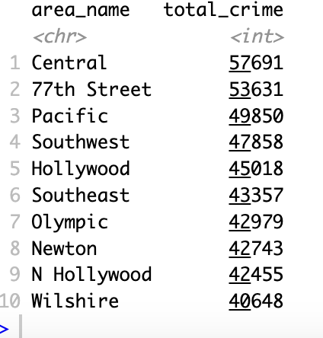
Areas with Most Crime Reported

Slide 13
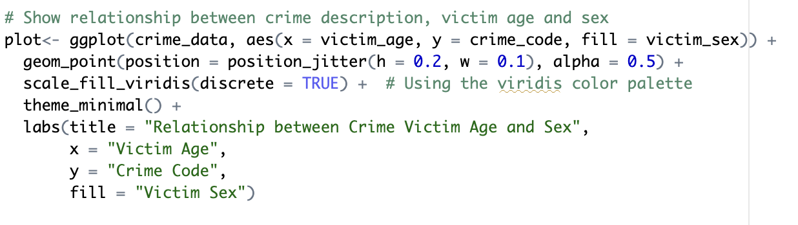
Victim Age and Sex Relationship

Slide 14
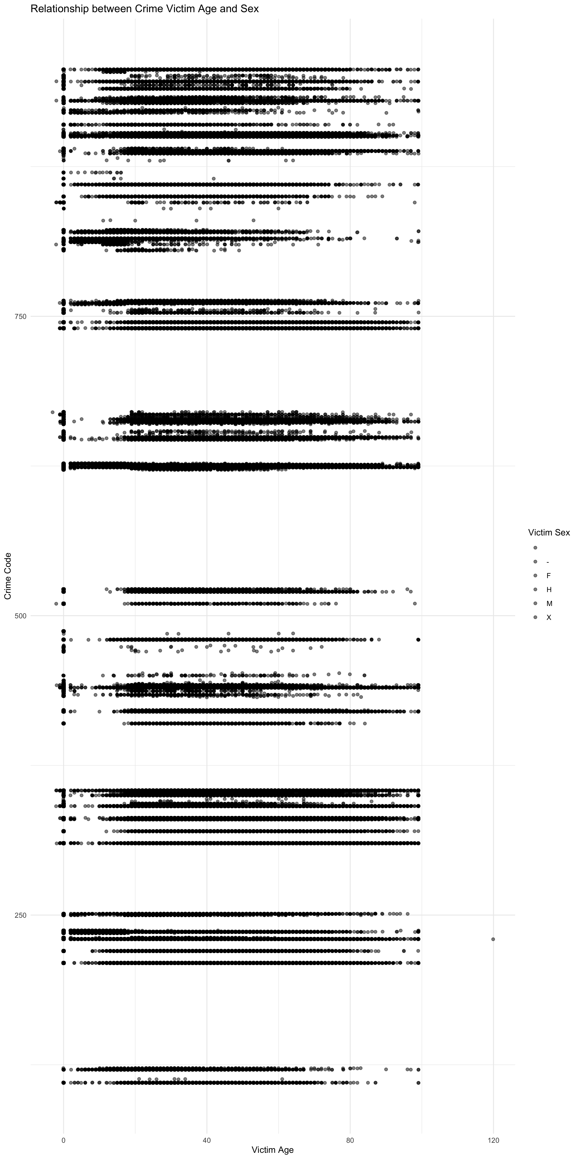
Victim Age and Sex Relationship

Slide 15
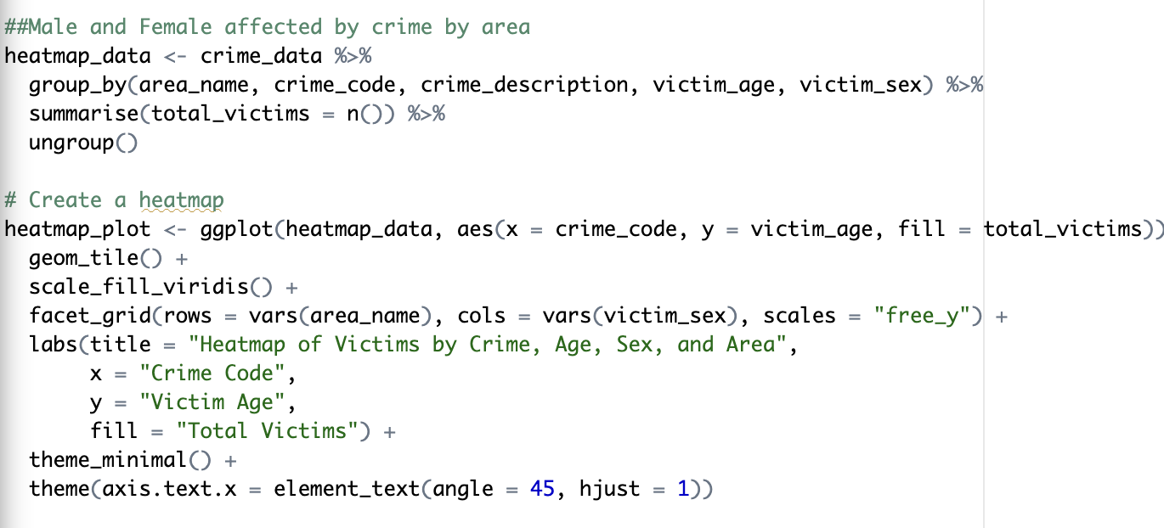
Victim Heatmap

Slide 16
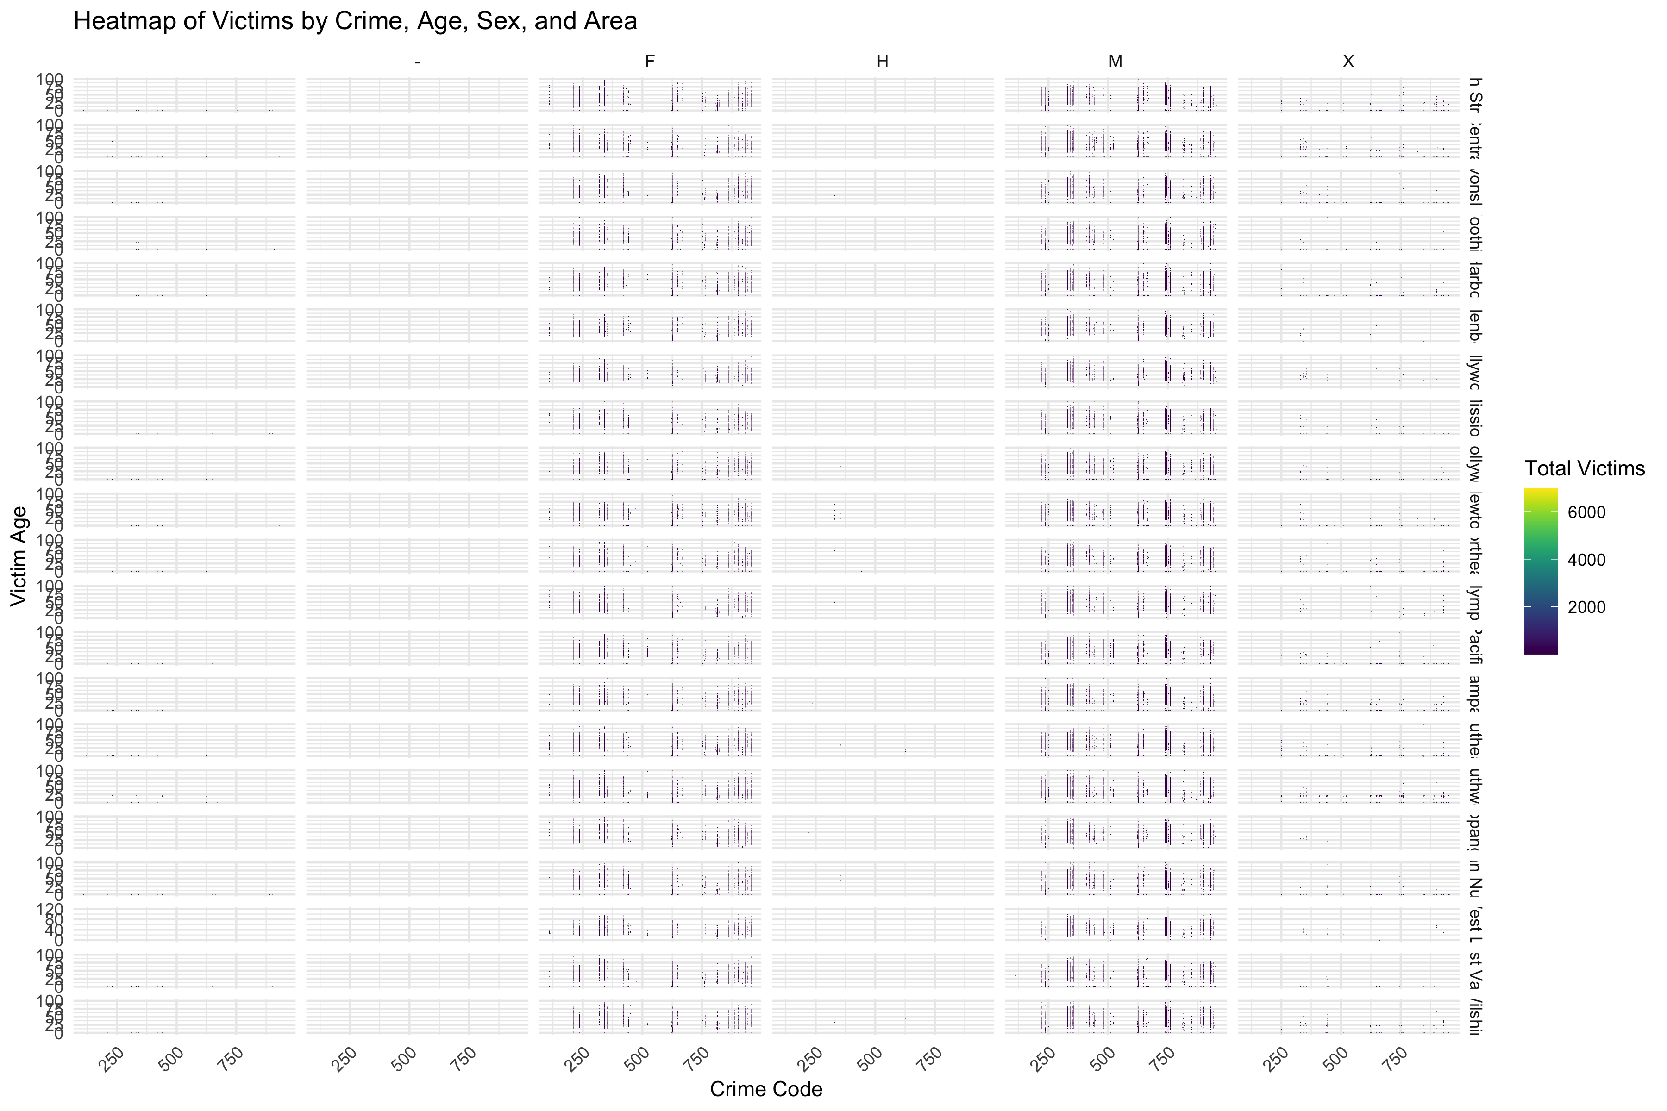
Victim Heatmap

Slide 17
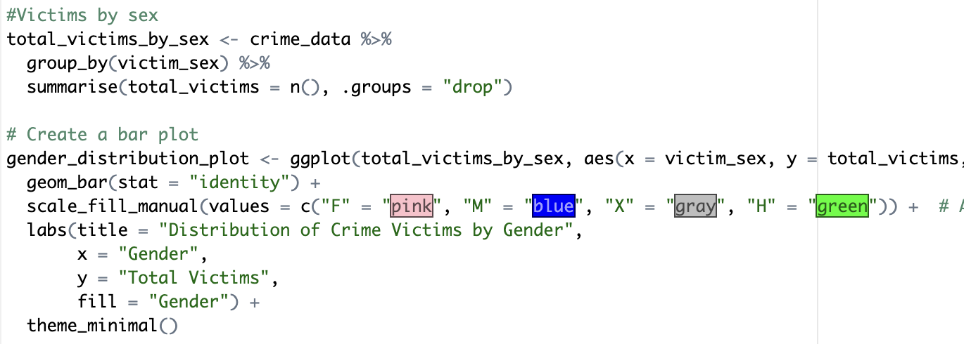
Crime Reported by Sex

Slide 18
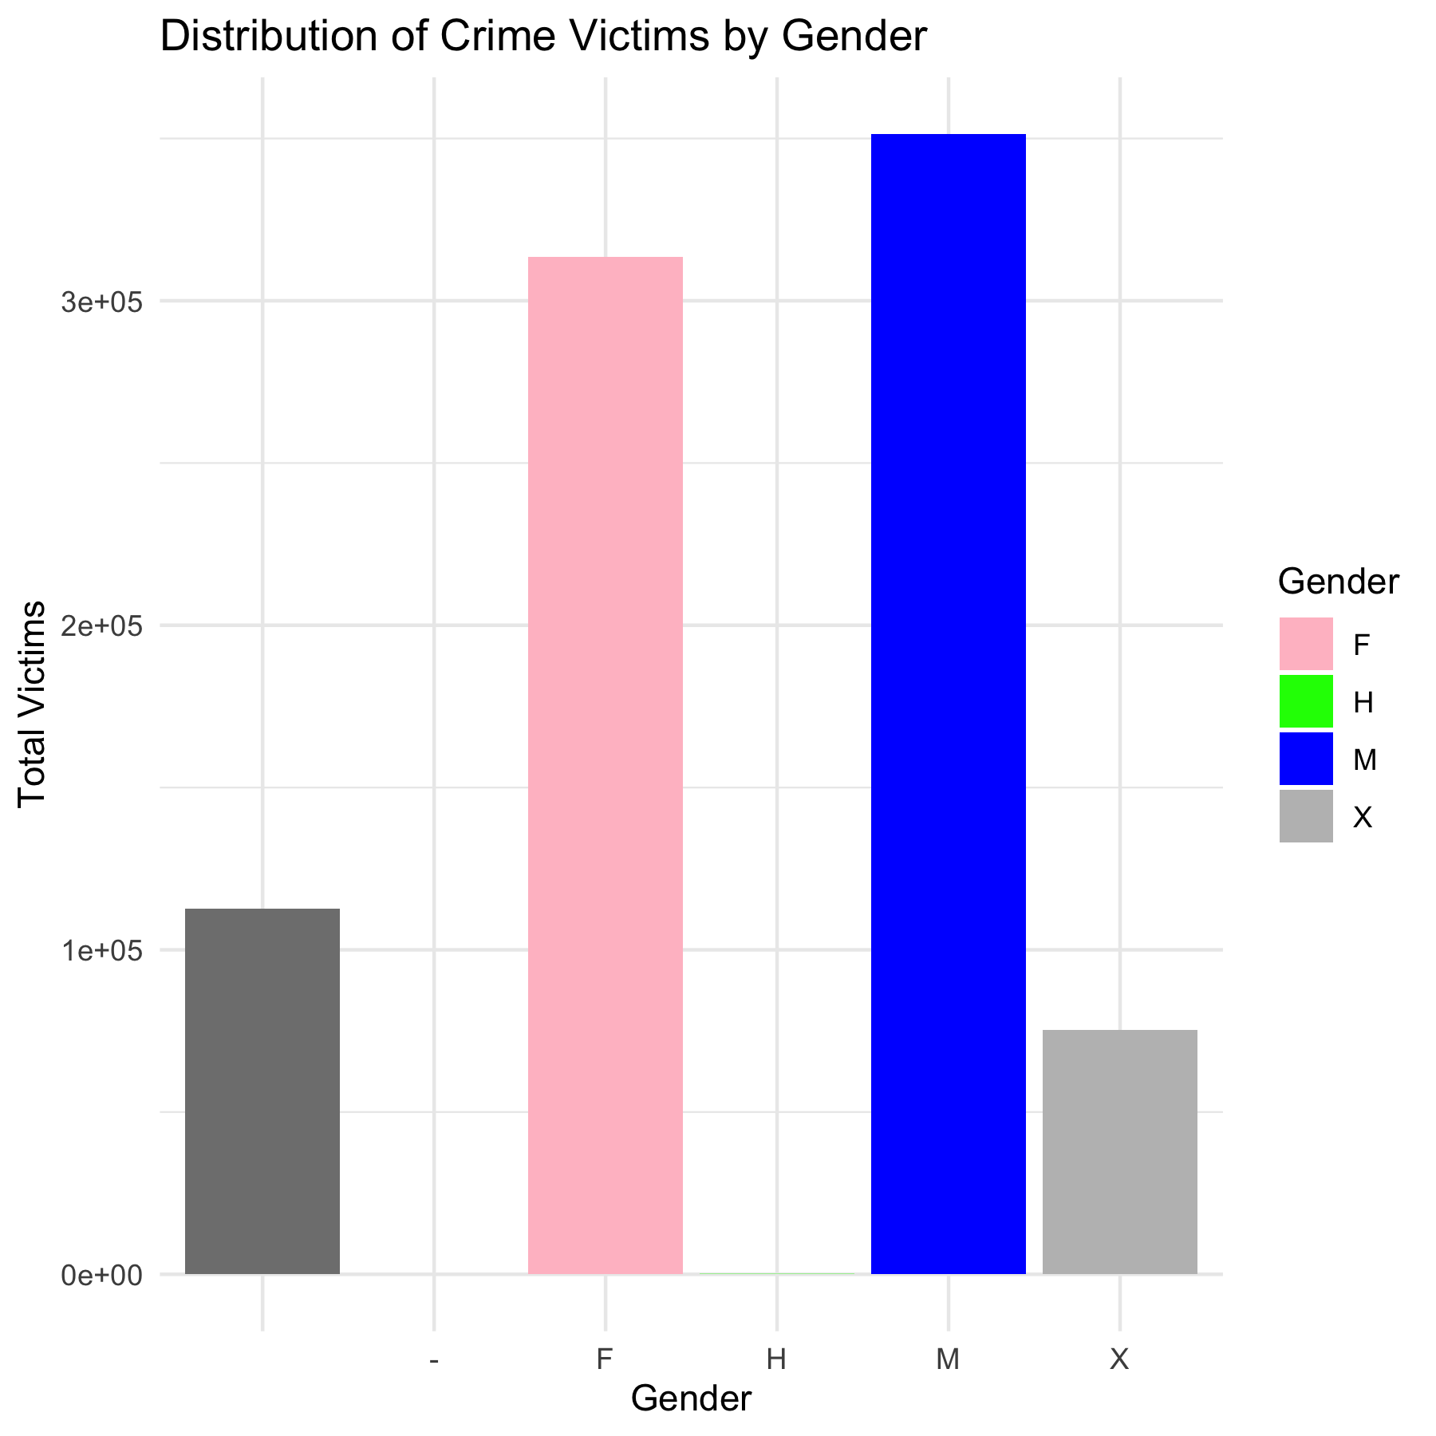
Crime Reported by Sex

Slide 19
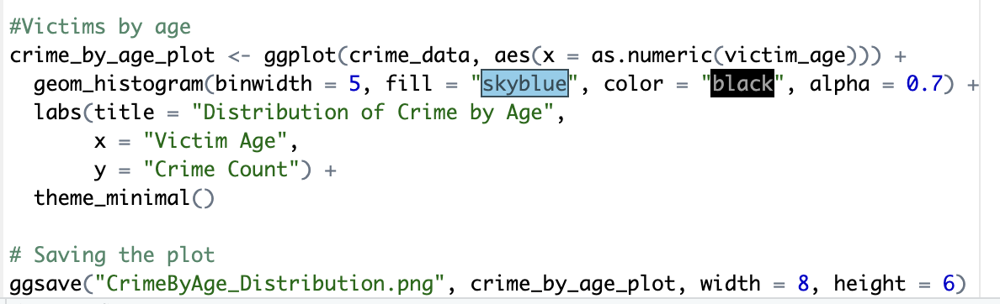
Crime Reported by Age

Slide 20
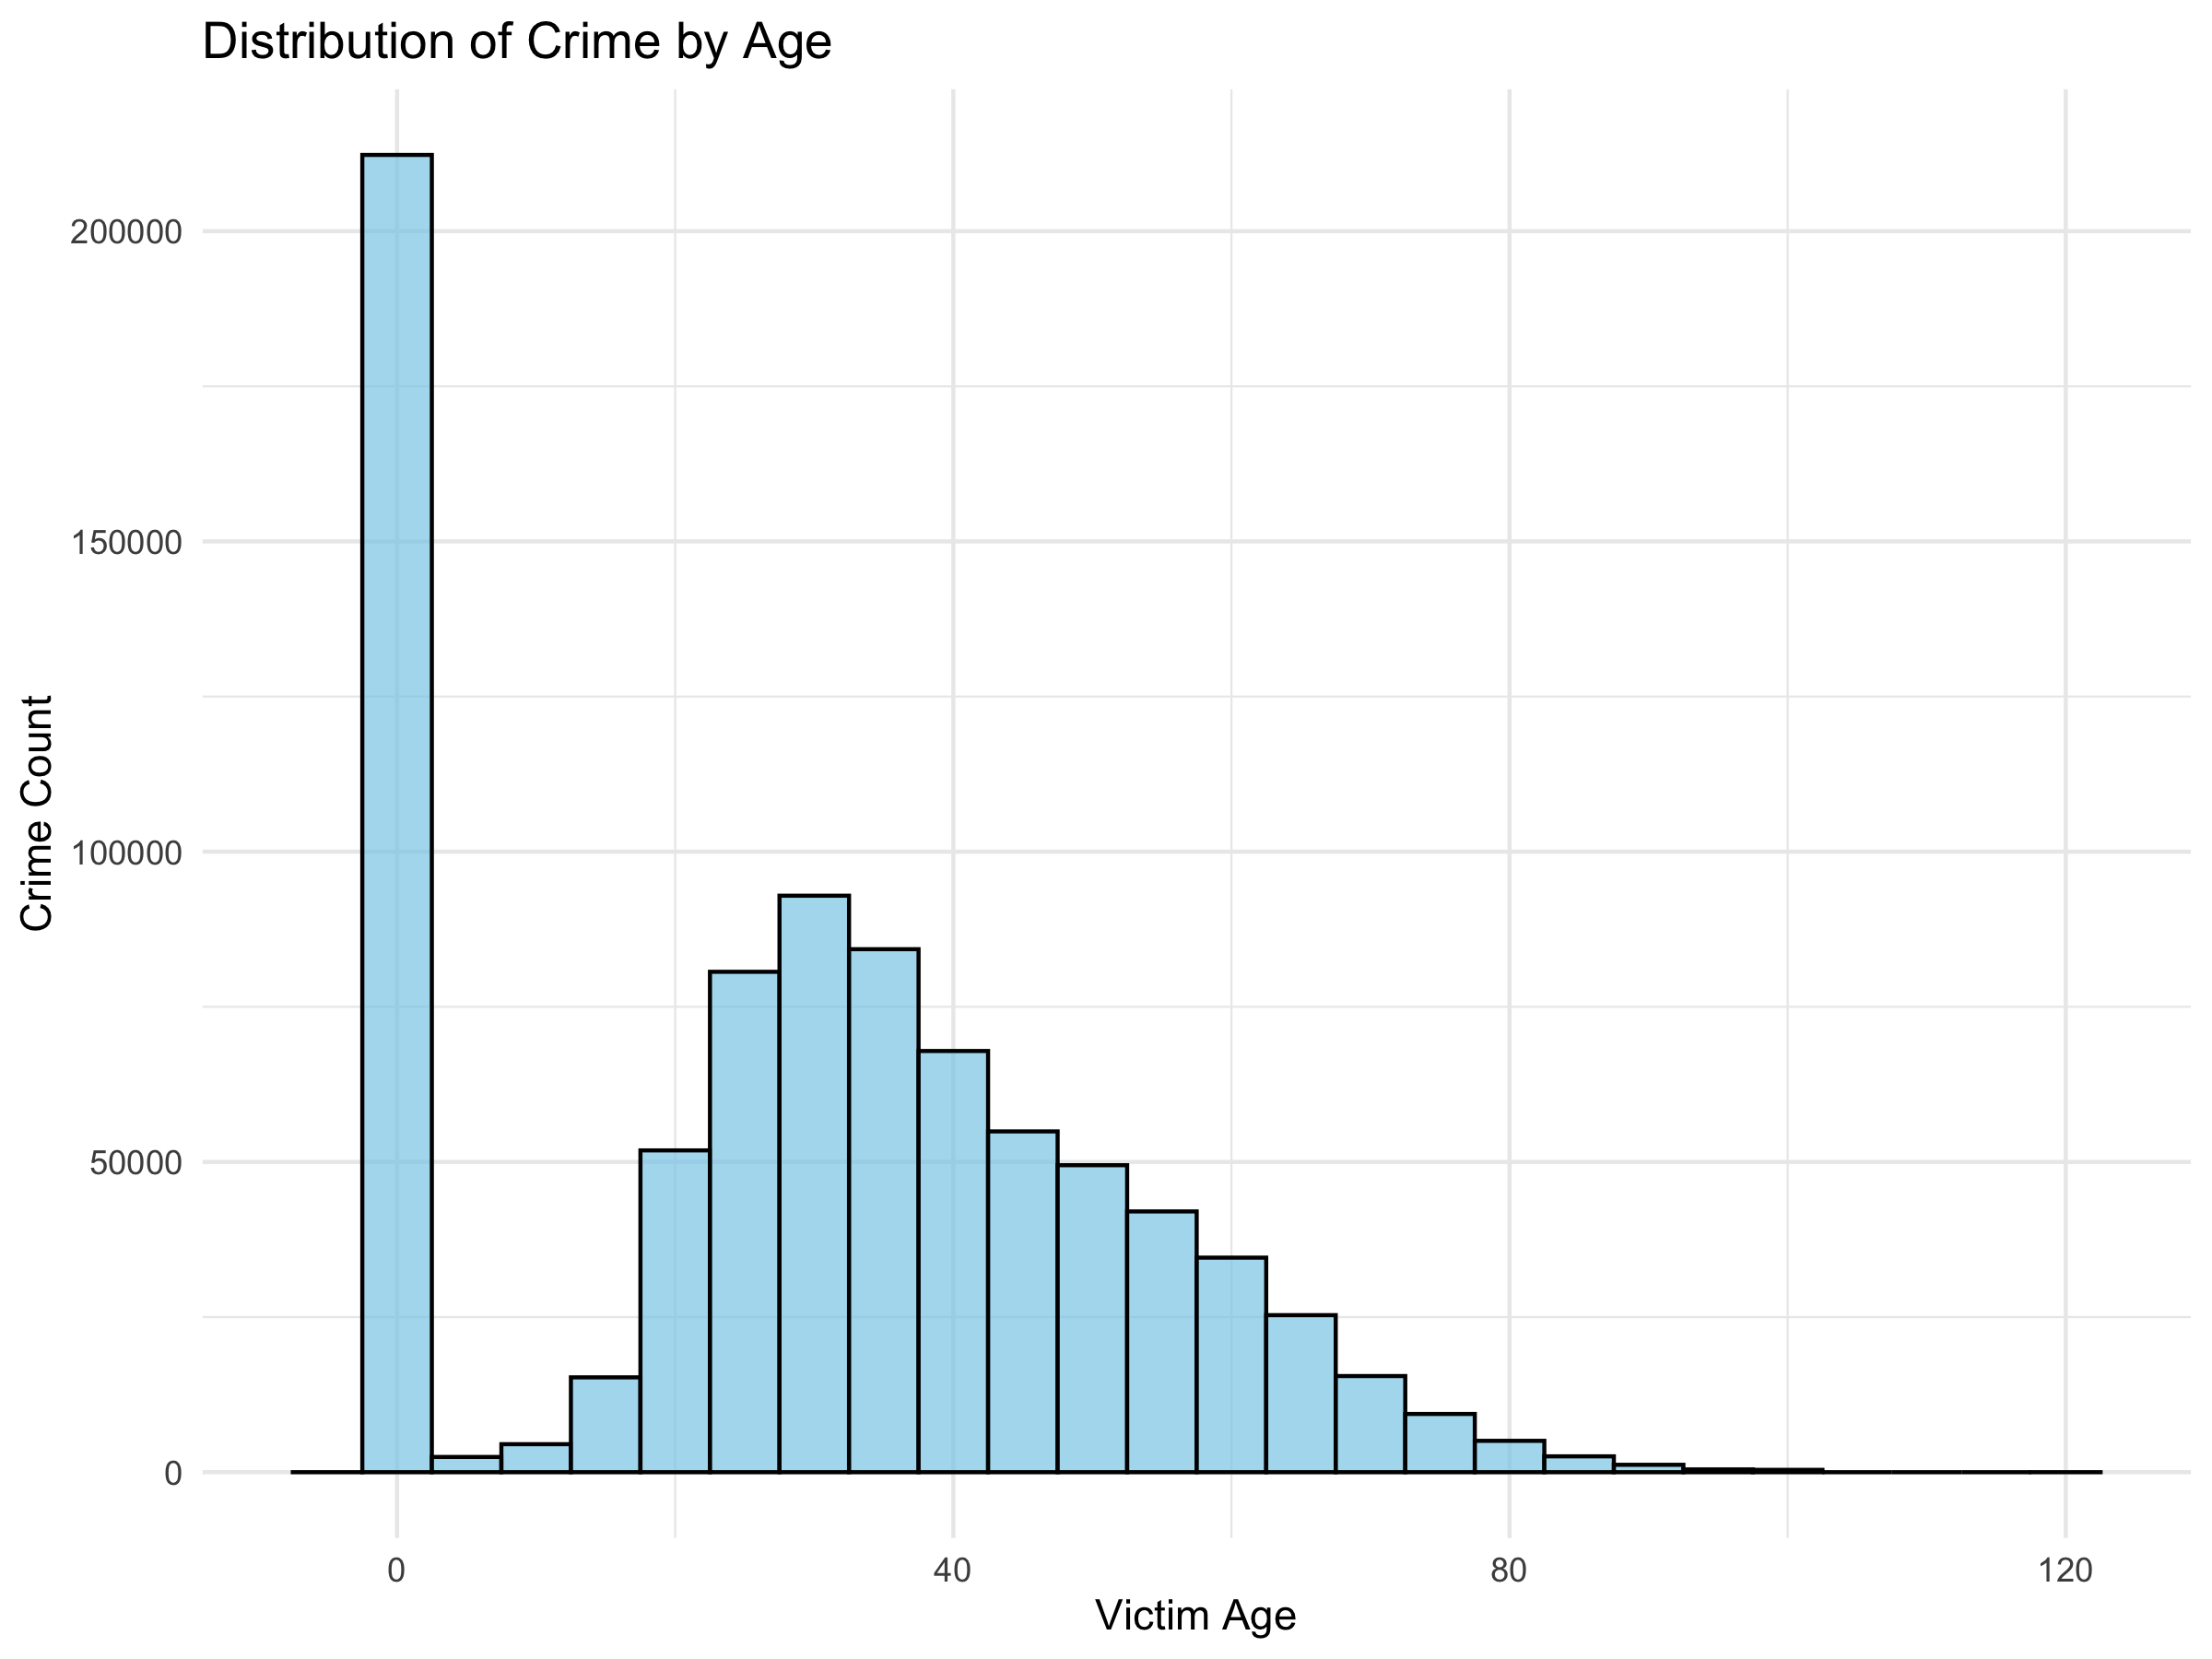
Crime Reported by Age

Slide 21

Conclusion
In conclusion, this R script takes us through a comprehensive analysis of crime data, leveraging various visualizations to uncover patterns and trends. The insights gained can inform law enforcement strategies, resource allocation, and community safety initiatives.

